Slide 1
Lecture 6
D&D Chapter 7 & 8 Intro to Classes and Objects

Slide 2
Goals
By the end of this lesson, you should
know how to process strings in Java
know how to define and use a class that has
Instance variables (with getter and setter methods)
Methods
Constructor

Slide 3
Strings
Strings
Classes
Instance variables
Setters and getters
Constructors
Using objects
Summary
Strings in Java are a special class of objects (class/type String). That is, they don’t just store a string of characters, but also provide methods that operate on that string. Here are some examples:
String a = "Hello World!"; // Note: Double quotes!
System.out.println(a);
String b = "Aotea";
String c = "roa";
System.out.println(b+c); // String concatenation with +
// Double quotes in strings:
System.out.println( "Aoteaora is also known as \"New Zealand\"");
// Measure string length with the length() method:
System.out.println(b + " has " + b.length() + " letters");
System.out.println(b + c + " has " + (b+c).length() + " letters");
// You can also use methods on string literals:
System.out.println("shout!".toUpperCase());
String d = b + c;
// Getting at substrings is easy:
System.out.println("Is there " + d.substring(2, 5) + " in " + d + "?");
// String lengths can change!
d += " aka New Zealand";
System.out.println(d + " has " + d.length() + " letters");

Slide 4
String comparison
Strings
Classes
Instance variables
Setters and getters
Constructors
Using objects
Summary
Comparing strings for identical content is a common task in programming. In Java, this can be a bit of a pitfall:
String x = "Black"; String y = "White";
// This seems to work:
if (x == y) {
System.out.println(x + " is " + y);
} else {
System.out.println(x + " is not " + y);
}
y = "Black";
if (x == y) {
System.out.println(x + " is " + y);
} else {
System.out.println(x + " is not " + y);
}
// Not really, though!
String z1 = "Aotea"; String z2 = "Ao";
z2 += "tea";
if (z1 == z2) {
System.out.println(z1 + " is " + z2);
} else {
System.out.println(z1 + " is not " + z2);
}

Slide 5
String comparison
Strings
Classes
Instance variables
Setters and getters
Constructors
Using objects
Summary
What went wrong here?
Remember that strings in Java are objects. Object variables are really just the memory addresses of the objects.
When we use ==, Java compares the memory addresses of the objects on either side of the ==. z1 and z2 are different objects with the same content, and are located at different addresses in memory.
When we store a string literal like "Black" or "White" in a String object, the Java VM tries to be efficient and stores the string literal only once, even if we assign it to a second variable.
If we create a string by concatenation, the VM doesn’t spot that we have just re-created the same string again and so stores it in two independent objects.
There’s got to be a better way than the comparison operators, and there is: the equals() method! if (z1.equals(z2)) { …

Slide 6
Class Example
Strings
Classes
Instance variables
Setters and getters
Constructors
Using objects
Summary
I want to have a class Rectangle from which I can instantiate various Rectangle objects (i.e., different rectangles).
Here’s the UML class diagram. My Rectangle class will have 3 attributes: length, width and area, and one method diagonal(), which will return the length of the rectangle’s diagonal.
Rectangle
+length: double
+width: double
+area: double
+diagonal(): double

Slide 7
Attributes and instance variables
Strings
Classes
Instance variables
Setters and getters
Constructors
Using objects
Summary
A class attribute (e.g., the length of a rectangle) normally becomes an instance variable. That is to say each Rectangle object has its own length.
Instance variables are considered private to the object, so we define methods to get and set the values that are public. In object jargon, these methods are known as getters and setters, or sometimes as accessors and mutators (perhaps because this sounds more sophisticated?).
In our case, the area of a
Rectangle depends on its width and length, though.
So if we store the area in an instance variable as well, we could end up with an inconsistent object.
Code outside the Rectangle class
setLength()
myRectangle1
length = 10;
width = 20;
getLength()

Slide 8
Re-cap: Make a class
Put the class in its own .java file. For these little projects, we have the classes in the same project and package (right click on the project name and select New/Class). Don’t tick the main() box. Our main() method will be in a different class.
You get an empty class:
public class Rectangle {
}
Next we add the instance variables and their getters and setters
Strings
Classes
Instance variables
Setters and getters
Constructors
Using objects
Summary

Slide 9
Instance Variables
Strings
Classes
Instance variables
Setters and getters
Constructors
Using objects
Summary
public class Rectangle {
private double length;
private double width;
public void setLength(double length) {
this.length = length;
}
public double getLength() {
return length;
}
public void setWidth(double width) {
this.width = width;
}
public double getWidth() {
return width;
}
}
Instance variables
Setter for length
Getter for length
Setter for width
Getter for width

Slide 10
this
public class Rectangle {
private double length;
private double width;
public void setLength(double length) {
this.length = length;
}
Strings
Classes
Instance variables
Setters and getters
Constructors
Using objects
Summary
Instance variable
Parameter
Instance variable
Parameter
Notice
setLength uses length as the method parameter. This will show in the auto-prompt in Eclipse thus reminding us of what to pass.
However, we now have two variables called length: the class instance variable and the method parameter. The method parameter is the one in scope and hides the instance variable. So we need another way to refer to the class instance: We use the keyword this: this.length to access the instance variable. Leaving the this. off creates a warning (orange underline) but NOT an error. So the program will run – it just won’t assign the value to the instance variable. Instead, it will assign the value of the parameter back to the parameter.

Slide 11
Why use setters and getters?
Strings
Classes
Instance variables
Setters and getters
Constructors
Using objects
Summary
Why are we using getters and setters here to access instance variables?
After all, we could simply declare the instance variables public, right?
Also, calling methods always takes longer than just storing a value. So why are we doing it the cumbersome way here? A lot of textbooks don’t mention this (Deitel and Deitel does).
Setters let us do things before we store the data passed to it: validate (e.g., for correct range), convert (e.g., store a value passed in NZ$ internally in US$), perform actions associated with the change of value (e.g., repaint a graphical object whose colour value we change).
Getters let us do things when we read data: convert, register the access, etc.
By using getters and setters from the start, we ensure that we can always add this functionality later.
public class Rectangle {
public double length;
public double width;
…
}

Slide 12
A setter and getter for the area
Strings
Classes
Instance variables
Setters and getters
Constructors
Using objects
Summary
Setters and getters don’t always need an underlying private instance variable.
Here, we use our two existing instance variables to store any area value we pass.
Since the area of a rectangle only tells us what the product of its length and width is, but not what the length and the width themselves are, we get to choose how to resolve this in setArea(). Here, we choose to make the rectangle a square whenever we set the area.
getArea() returns a computed value.
public class Rectangle {
…
public void setArea(double area) {
length = Math.round(Math.sqrt(area));
width = length;
}
public double getArea() {
return length*width;
}
}

Slide 13
Constructor Methods
Classes have constructors – these are special methods evoked when you instantiate a new Object. A constructor:
Has the same name as the class
Doesn’t have a return value – it automatically returns the object.
Can be overloaded.
Can call other overloaded constructors with this(…);
Rectangle has 3 constructors, 1. The default constructor, makes a square of area 1. 2. Sets the length and width as the object is instantiated.
3. Makes a square of the given area.
Strings
Classes
Instance variables
Setters and getters
Constructors
Using objects
Summary
public Rectangle() {
this(1,1);
}
public Rectangle(double length, double width) {
this.length = length;
this.width = width;
}
public Rectangle(double area) {
this(Math.round(Math.sqrt(area)), Math.round(Math.sqrt(area)));
}
this refers to the overloaded constructor

Slide 14
Other Methods
Any other methods are defined in the standard way.
private for those just available to the objects
public for those available to any object of the class (most frequent).
public static for those available directly from the class without the object being instantiated.
This method returns the length of a Rectangle’s diagonal:
public class Rectangle {
…
public double diagonal() {
return Math.sqrt(length*length+width*width);
}
}
Strings
Classes
Instance variables
Setters and getters
Constructors
Using objects
Summary

Slide 15
Instantiating (Making) Rectangles
Now we create another class RectangleExamples. Add a main() to it and instantiate a few rectangles:
public static void main(String[] args) {
Rectangle r1 = new Rectangle(); // just a 1 x 1 square
Rectangle r2 = new Rectangle(4); // a 2 x 2 square
Rectangle r3 = new Rectangle(6,4); // a 6 x 4 rectangle
System.out.println("r1 is a " +
r1.getLength() + " by " +
r1.getWidth() + " with area " +
r1.getArea() + " and diagonal " +
r1.diagonal()
);
System.out.println("r2 is a " +
r2.getLength() + " by " +
r2.getWidth() + " with area " +
r2.getArea() + " and diagonal " +
r2.diagonal()
);
System.out.println("r3 is a " +
r3.getLength() + " by " +
r3.getWidth() + " with area " +
r3.getArea() + " and diagonal " +
r3.diagonal()
);
}
Strings
Classes
Instance variables
Setters and getters
Constructors
Using objects
Summary

Slide 16
A bunch of rectangles!
Well, an ArrayList really:
ArrayList<Rectangle> rectangles = new ArrayList<Rectangle>();
rectangles.add(r1);
rectangles.add(r2);
rectangles.add(r3);
for (Rectangle r: rectangles) {
System.out.println("We have a " +
r.getLength() + " by " +
r.getWidth() + " with area " +
r.getArea() + " and diagonal " +
r.diagonal()
);
}
Strings
Classes
Instance variables
Setters and getters
Constructors
Using objects
Summary

Slide 17
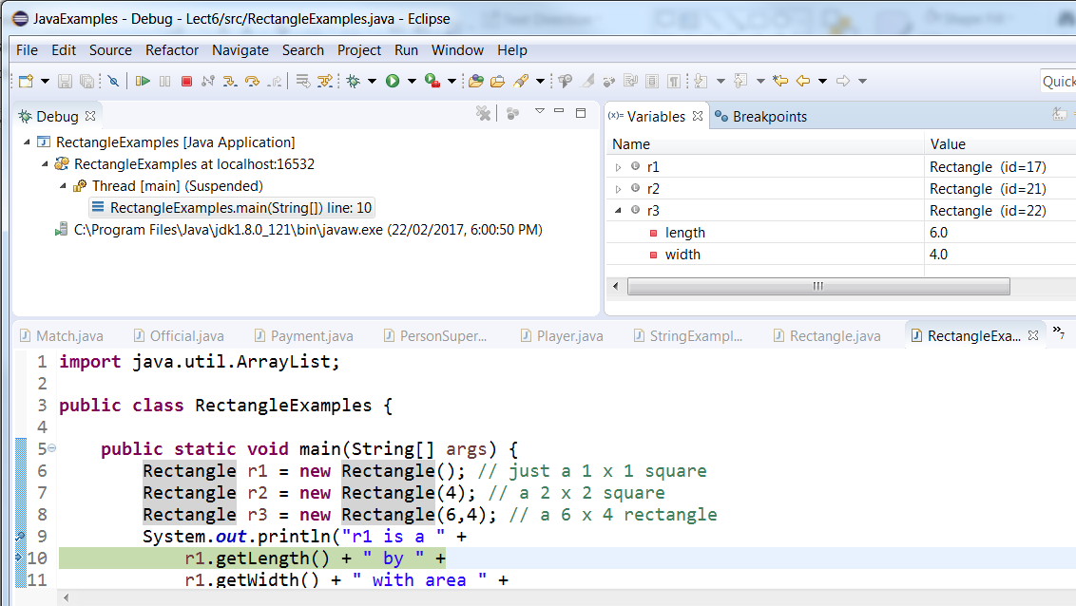
Debug
Strings
Classes
Instance variables
Setters and getters
Constructors
Using objects
Summary

Slide 18
What do we know
Strings
Classes
Instance variables
Setters and getters
Constructors
Using objects
Summary
A class
Is in its own .java file (at this stage)
Its attributes become
Private instance variables with
Each with a get and a set method
Use this. to change the instance variable
A class can have one or more Constructor methods they
Are the same name as the class
Do not have a return type specified
Often set some of the attributes of the newly instantiated object
Constructors can call each other using this()
A class can have both private and public methods that receive and return values
Static variables and methods are Class elements and there is only one of them for all of the objects of that class.
The class is now a java type available in your project.
You can use it to instantiate objects
You can use your new type in much the same way as any other type – e.g. make an ArrayList of the objects

Slide 19
Resources
D&D chapter 7& 8, also 14.1 to 14.3
https://docs.oracle.com/javase/tutorial/java/javaOO/
Homework.
Review questions in chapter 7 or D& D
Play with example program. Add another class ‘Triangle’, give it some attributes and methods.
Look at what is going on with debug.

Slide 20
Next Lecture
D&D Chapters 7 & 8
Objects (2)
enums

